Slide 1
Behavioral changes due to COVID-19
By: Nathan B., James P., and Alex O.

Slide 2
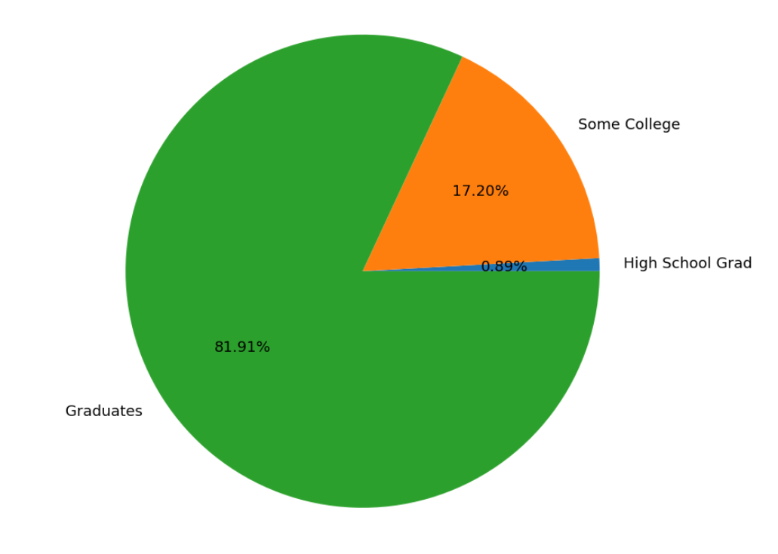
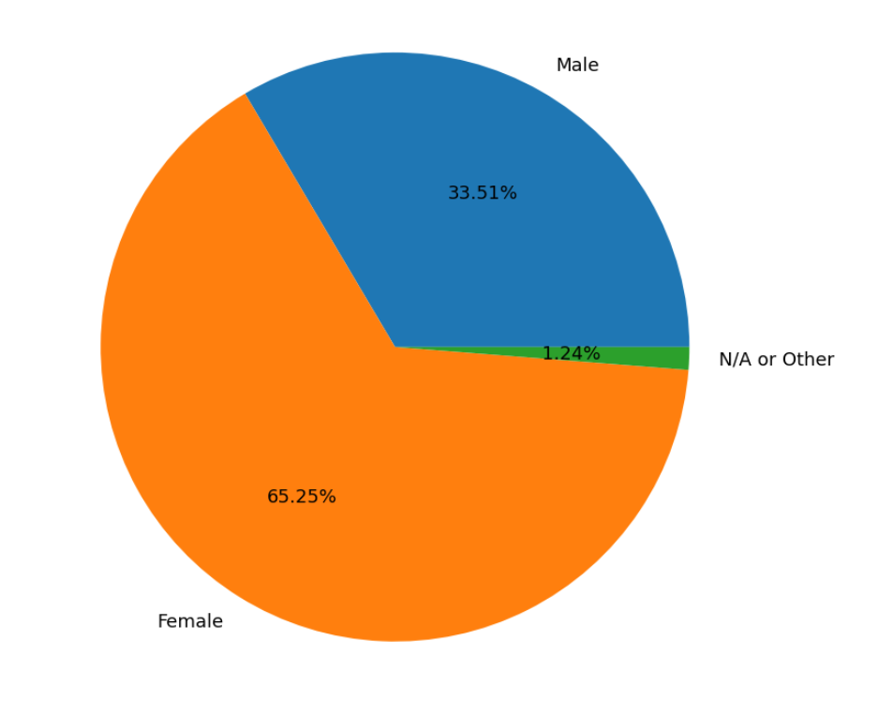
This is not representative of the US population
Even though we have a decent spread of people across the country, the majority of people represented here have a high level of education
This alone would correlate to better economic/living conditions which has a large influence on the data points being presented here
82% vs 13.1% according to the US Census

Slide 3
The definition of the Quality of Life
WHO defines quality of life as “an individual's perception of their position in life in the context of the culture and value systems in which they live and in relation to their goals, expectations, standards and concerns”
WHOQOL measures six domains to gauge overall quality of life
Physical capacity
Psychological
Level of Independence
Social Relationships
Environment
Spirituality/Religion/Personal beliefs
Our main focus will be on the level of independence and environment domains, with some speculation on psychological effect

Slide 4
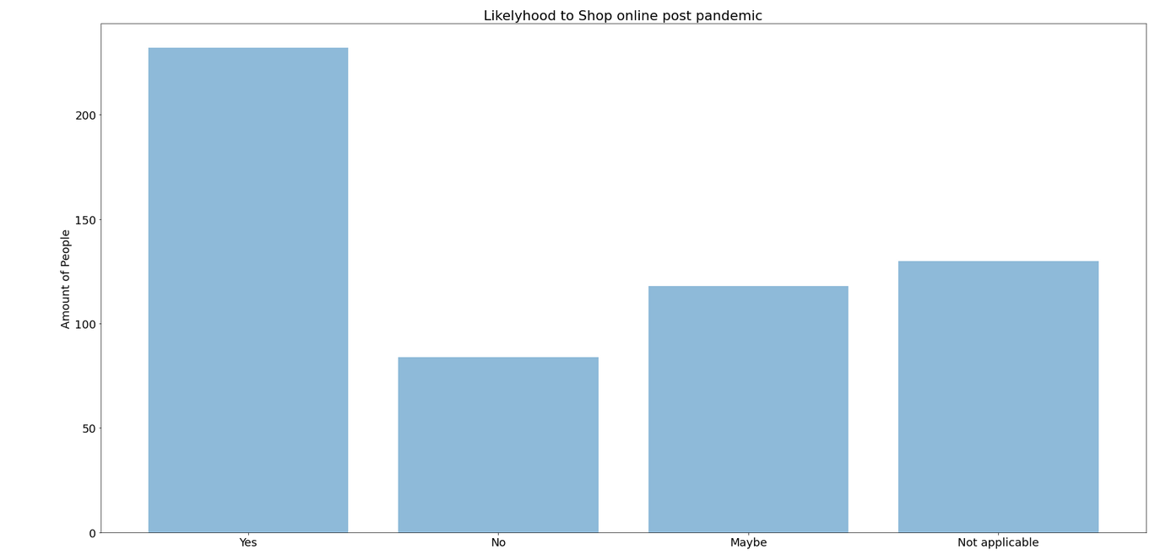
Do the socio-demographic characteristics of the respondents correlate with their behavioral changes?

Slide 5
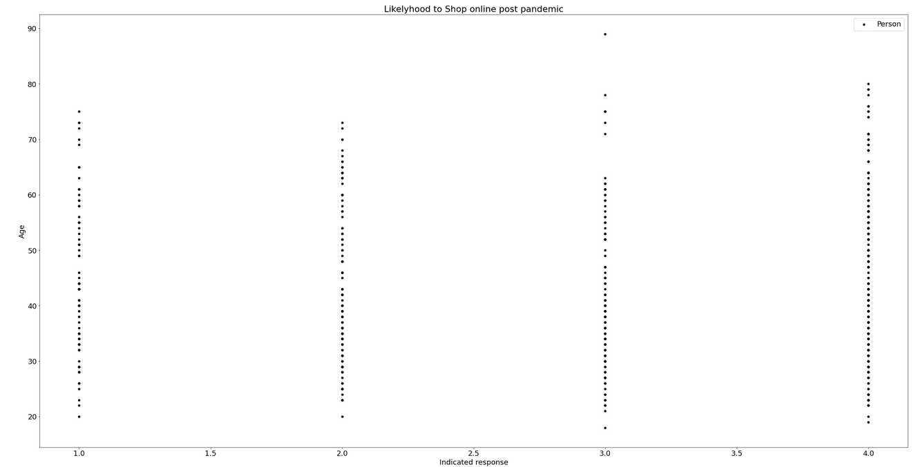
Age not heavily correlated with want to shop online

Slide 6
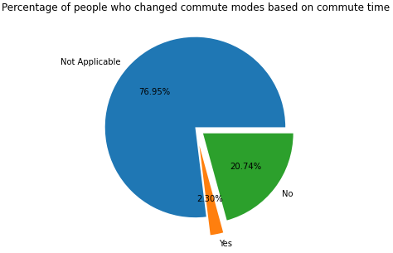
Does the place of residence and its urban form significantly influence the way they travel to work before and after the pandemic?
The majority of people did not have their commute time change as a result of COVID-19
Even if they did, the majority did not change their commute mode

Slide 7
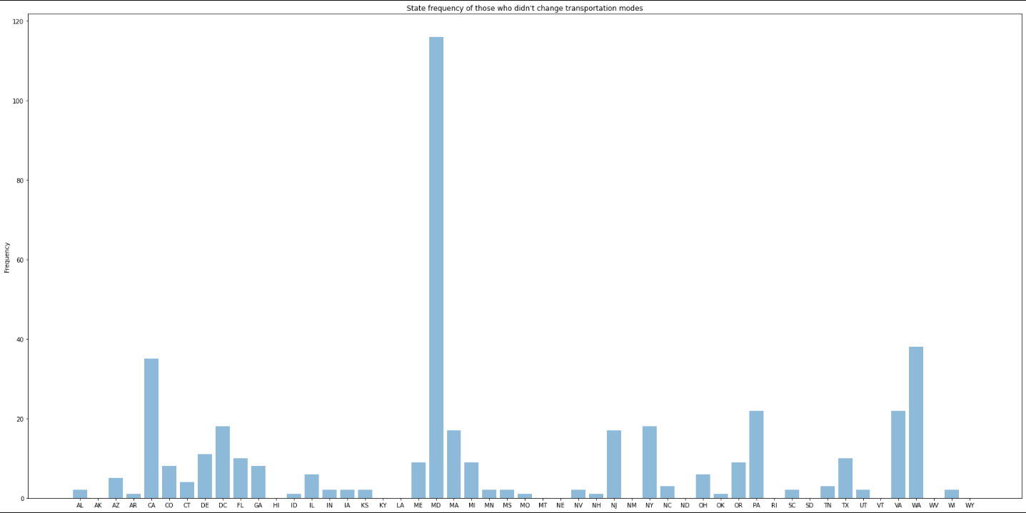
This graph shows the general trend that those who didn’t have their commute time change generally came from more population dense states

Slide 8
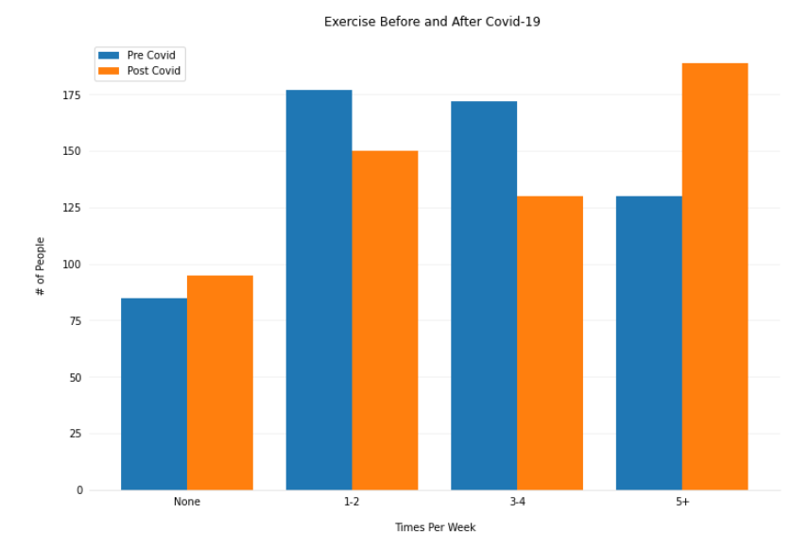
How would you analyse the changes in the level of physical activity after the lockdown?
The trend seems to show that individuals overall began exercising more at the high end and less at the low end
This might be due to an increase in free time during Covid

Slide 9
High end increases; low end also increases. Only the middle drops.

Slide 10
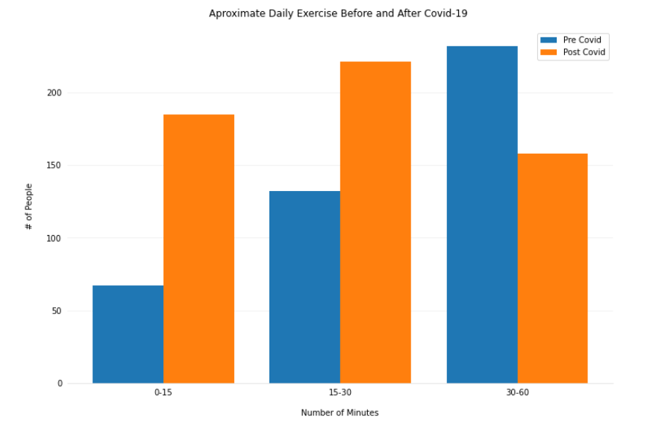
Data evens out more; people exercise more consistently, but for shorter amounts of time.

Slide 11
Thank you for listening!

